Slide 1

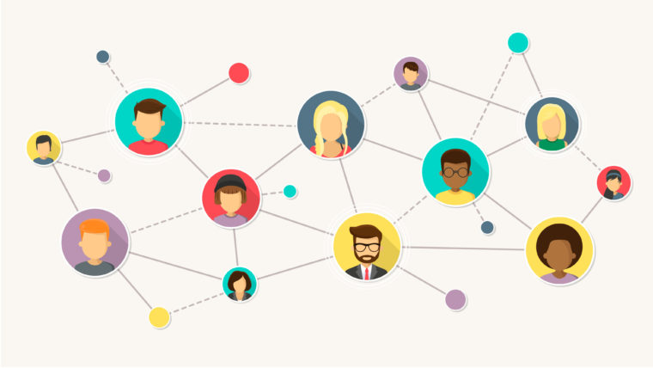
CS Connect hub
Team CodeBusters – Drashtee Parmar, MSCS
Sairam Abhishikth Vadlamani, MSCS
Krishna Chaitanya Naraparaju, MSCS

Slide 2
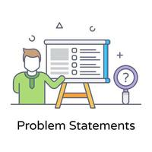
Problem statement
To develop a platform where students can connect with faculty, alumni, and student assistants to aid students academically, professionally and their campus life.

Slide 3

Solution
We have developed a website where the student can be assisted by a professor/ Teaching Assistant/ Alumni based on their doubt.
Moreover, we incorporated the chatbot facility which will help the students to get a detailed response.
Leveraging the "OpenAI API" will help the chatbot to generate detailed responses for the students' questions.
Notes:
Assurant way purpose:
Doing something different – Using OpenAI API as initial step instead of directly sending messages to Professor, AI implementation to reduce the workload on professor. It answers initially, feedback is taken. And if it's not resolved an email is sent to professor with the data of the chat so that they can better address the issue. Professor has their own free time.
This can be said as fusion of AI chatbot technology, faculty communication
Connecting vast group of student community with faculty and alumni, other students. Can connect online students to offline people too.
Particularly target new students as they can connect with faculty easily and the platform provides them a way and method to connect

Slide 4
Problems addressed
Students can have diverse set of questions which can be addressed by Professors/Alumni/Carrer Advisors/TA/Program Coordinators during office hours or via email.
Providing streamlined support reduces workload, wait times, and giving prompt responses to the students.

Slide 5

deliverables
The website is presently limited to CS department with a handful of predefined professors.
AI chatbot is available in our website which leverages the mighty "OpenAI API".
For now, we have only implemented the AI chatbot, new features will be added in the future.
Solutions include both Equations and Textual answers.

Slide 6

Time constraints
Due to time restrictions, we started implementing the Faculty Tab as it aligns with most of the personas.
We're working on implementing it for the other tabs, Alumni and the Student Advising page, where they can get career advising and tutoring.
We could have deployed the web application in any server, and it can cater to all KSU students.
Notes:
If we had 12 hrs extra to spare

Slide 7
FLOW CHART
Loop continues until reset button is pressed. (Data is collected and stored)
Student selects from 3 tabs of faculty, alumni, students. Student is guided to Interior Page
Data sent back from OpenAI is displayed on the Interior page and student responds again with necessary question
Server collects data of the selection, student's question and sends it to OpenAI
Interior page
HOME PAGE
BACK-END
Once any of the options are selected in the interior page, data is sent to Back-End
OpenAI uses API Key and generates the answers to the questions sent and sends data back to server
Interior page
openai

Slide 8
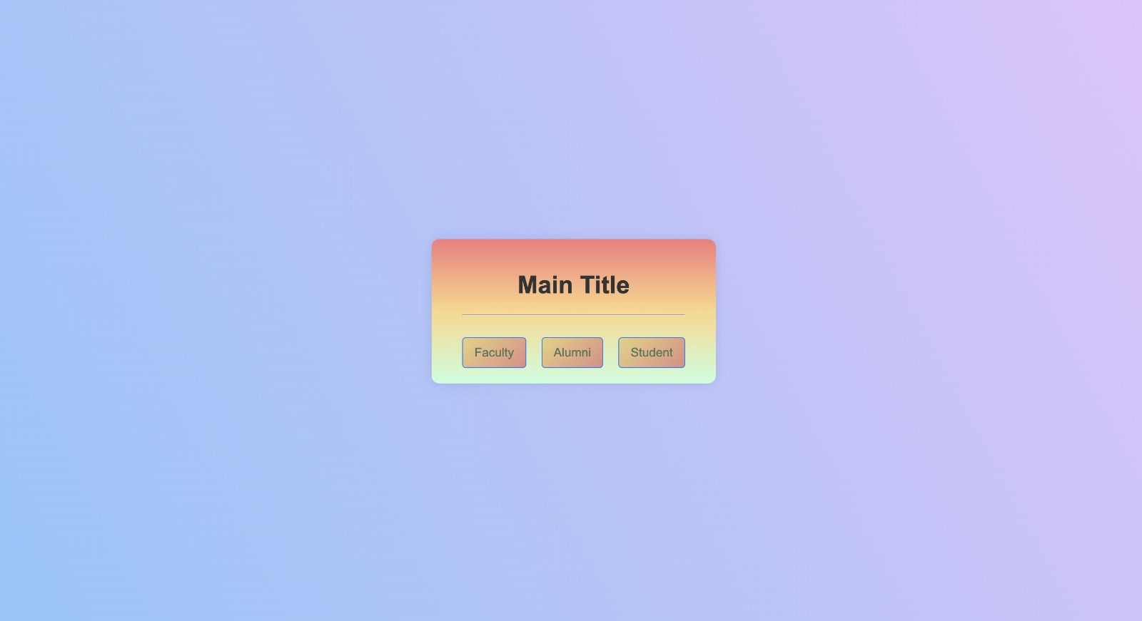
HOME PAGE

Slide 9
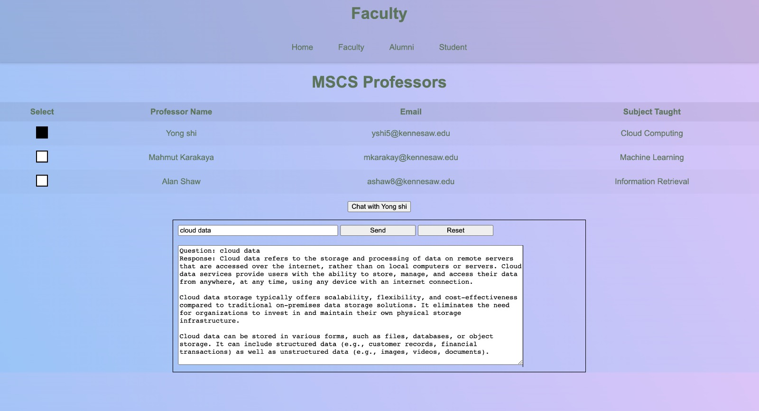
Interior page

Slide 10
Live demo

Slide 11

Multi-tab feature
Chat extension feature
Feature to send email to professor from chat along with chat data
Expansion of the website to include other departments of University
A tab for non-academic related queries
Notes:
Future development
Implementation of multiple tabs where student can open a new tab and continue chat or ask questions to two professors simultaneously (can try in next 12hrs)
Option to send an email to professor directly from website with chat data and option to schedule a meeting (next 12hrs)
Integrate other non-academic stuff into it so that students can also have socializing options
Expand it to other departments of University and various degrees

Slide 12
THANK YOU

